Slide 1
Grain Elevator System
Team 4
Hau Chan
Kit Cheng
Nick Pearson

Slide 2
Overview
Introduction
Product Vision and Project Scope
Target Markets and Stakeholders
Use Case Model
Software Architecture Document
Detailed Design Document

Slide 3
Introduction
We are designing software for a Grain Elevator system based on a given SRS. The software must track all grain transactions and the state of the twelve silos. In addition, the software must interact with the elevator manager to satisfy requirements such as generating two different reports, providing accurate information, and updating input data.

Slide 4
Product Vision and Project Scope
Product Vision Statement – The Grain Elevator System keep track transaction of grain as well as automatically choosing a silo for storage, thus increasing efficiency for handling process and making better use of storage resources.
Major Features – Grain Elevator System will
  Handles shipments of grain
  Maintains a shipment transaction log
  Produce a report of elevator state
Project Scope – The current project will create software necessary to field a viable product.

Slide 5
Target Markets and Stakeholders
The Grain Elevator System is for commercial grain storage companies needing to store multiple types of grain in many different silos of various sizes.
Developers – The three-member Grain Elevator System term.
Purchasers – Grain Storage Companies.

Slide 6
Use Case Model - Actors
Elevator manager – a person who is in charge of the elevator system
Truck – a vehicle that delivers grain
Rail car – a vehicle that loads grain
Accountant – a person who maintains financial-related information of the elevator system.

Slide 7
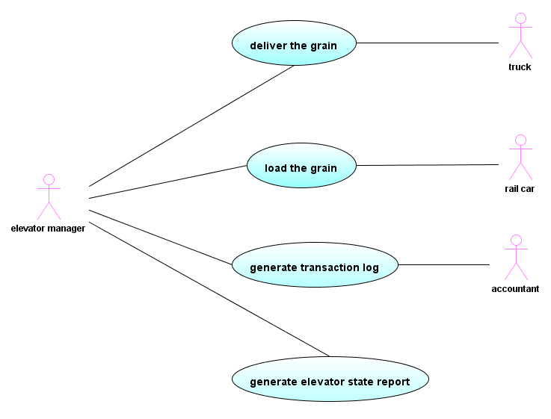
Use Case Model - Diagram

Slide 8
Use Case Model - Description
Use Case 1: Deliver the grain
Use Case 2: Load the grain
Use Case 3: Generate the transaction log
Use Case 4: Generate the report of the state of the elevator

Slide 9
Use Case 1: Deliver the grain
Actors: Elevator Manager, Truck
Stakeholders and Needs:
  Elevator Manager – To operate the system and record the information of the grain’s location
Preconditions:
  The truck is at the grain elevator with a known amount and type of grain.
Postconditions:
  A location is designated for the grain. The transaction log is updated.
Trigger:
  Elevator manager chooses “Receive Shipment” option on the interface of the elevator system.

Slide 10
Use Case 1: Deliver the grain
Basic Flow:
  Elevator manager identifies himself to initiate the elevator system.
  Elevator manager informs the system of the type, the grade, and the quantity of grain.
  The system selects one or more silos to store the grain and displays the information.
  Elevator manager input the information of the truck identifier, the driver, and the seller.
  The system confirms the input and records the arrival time and date and elevator manager.
  The truck delivers the grain in the silos.

Slide 11
Use Case 1: Deliver the grain
Extensions:
*a. Elevator manager cancels the operation: The use case ends.
1a. Elevator manager identifier is invalid:
1a1. Elevator system alerts the manager to the problem.
1a2. Elevator manager input correct identifier and activity resumes.
2a. Elevator system detects invalid or incomplete data:
2a1. Elevator system alerts the manager to the problem.
2a2. Elevator manager corrects the problem and activity resumes.
3a. Space is not enough for grain:
3a1. Elevator system accepts part of the load and displays how much grain is stored. The use case continues.
3b. No space for grain:
3b1. Elevator system informs the user that all the silos are full. The use case ends.
4a. Elevator system detects invalid or incomplete data:
4a1. Elevator system alerts the manager to the problem.
4a2. Elevator manager corrects the problem and activity resumes.

Slide 12
Software Architecture Document
(SAD)

Slide 13
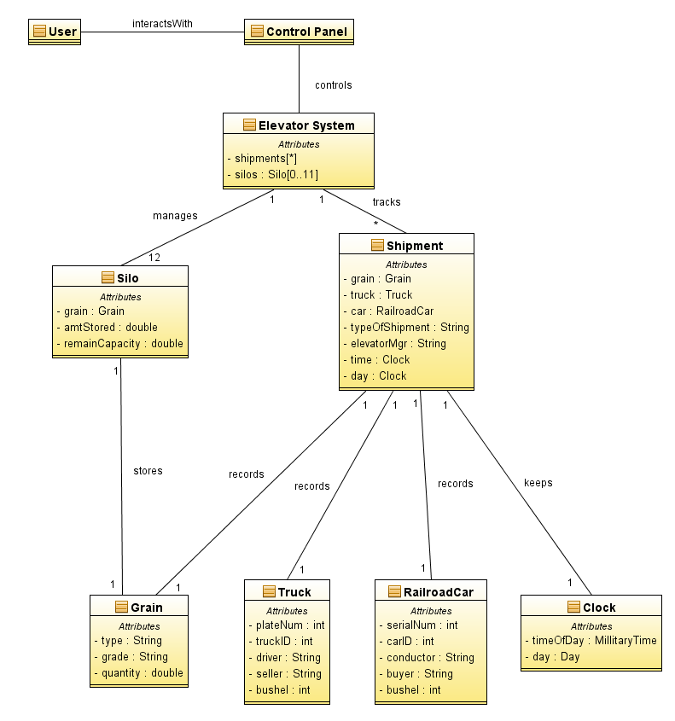
Conceptual Model

Slide 14
Functional Decomposition
User Interaction
Grain Delivery
Grain Loading
Elevator State Report
Shipment
Transaction Log
Find Silos
Silo state
Shipment
Legend
Interacts With
Component
Data Store

Slide 15
Non-functional Decomposition
User Interface
Device Interface
Keypad
Display
Elevator Control
Silo Control
Shipment Control
Legend
Module
Interacts With
Part Of

Slide 16
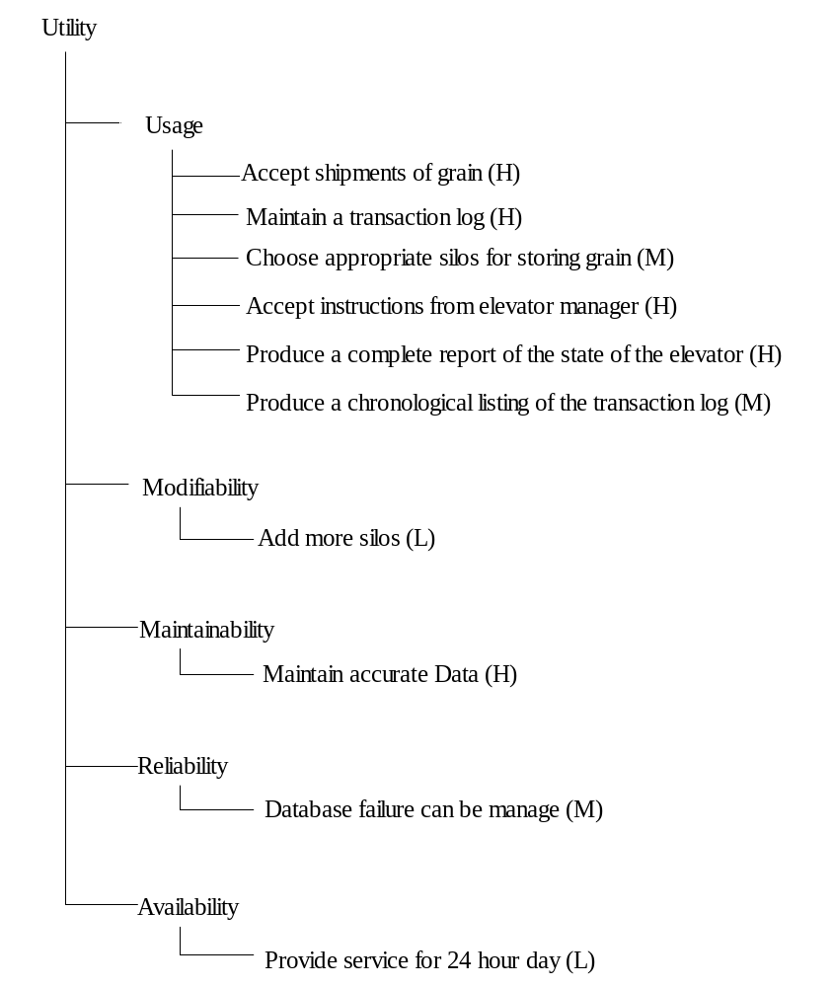
Utility Tree

Slide 17
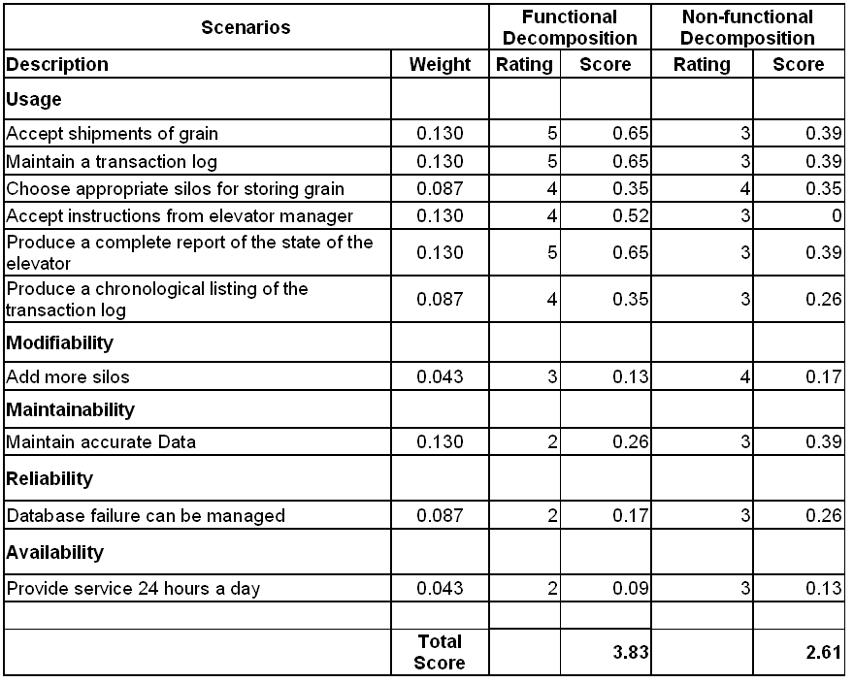
Scoring Matrix

Slide 18
Architectural Models
According to evaluation of two architectures by scenarios and scoring matrix, we choose the functional decomposition model since the overall score is higher.

Slide 19
UserInterface
1
interacts
1
<<interface>>
SystemController
- login()
- logout()
GrainTransaction
- silos : Silo [0..11]
ReportGeneration
- shipment [*]
1
1
tracks
manages
*
12
Shipment
- grain : Grain
- truck : Truck
- car : RailroadCar
- typeOfShipment : String
- ElevatorMgr : String
- time : Clock
- day : Clock
Silo
- grain : Grain
- amtStored : double
- remainCapacity : double
1
records
records
1
1
1
records
records
<<interface>>
Clock
1
1
1
1
Grain
- type : String
- grade : String
- quantity : double
Truck
- plateNum : int
- truckID : int
- driver : String
- seller : String
- bushel : int
RailroadCar
- serialNum : int
- carID : int
- conductor : String
- buyer : String
- bushel : int
RealClock
timeOfDay : MilitaryTime
day : Day

Slide 20
Detailed Design Document
(DDD)

Slide 21
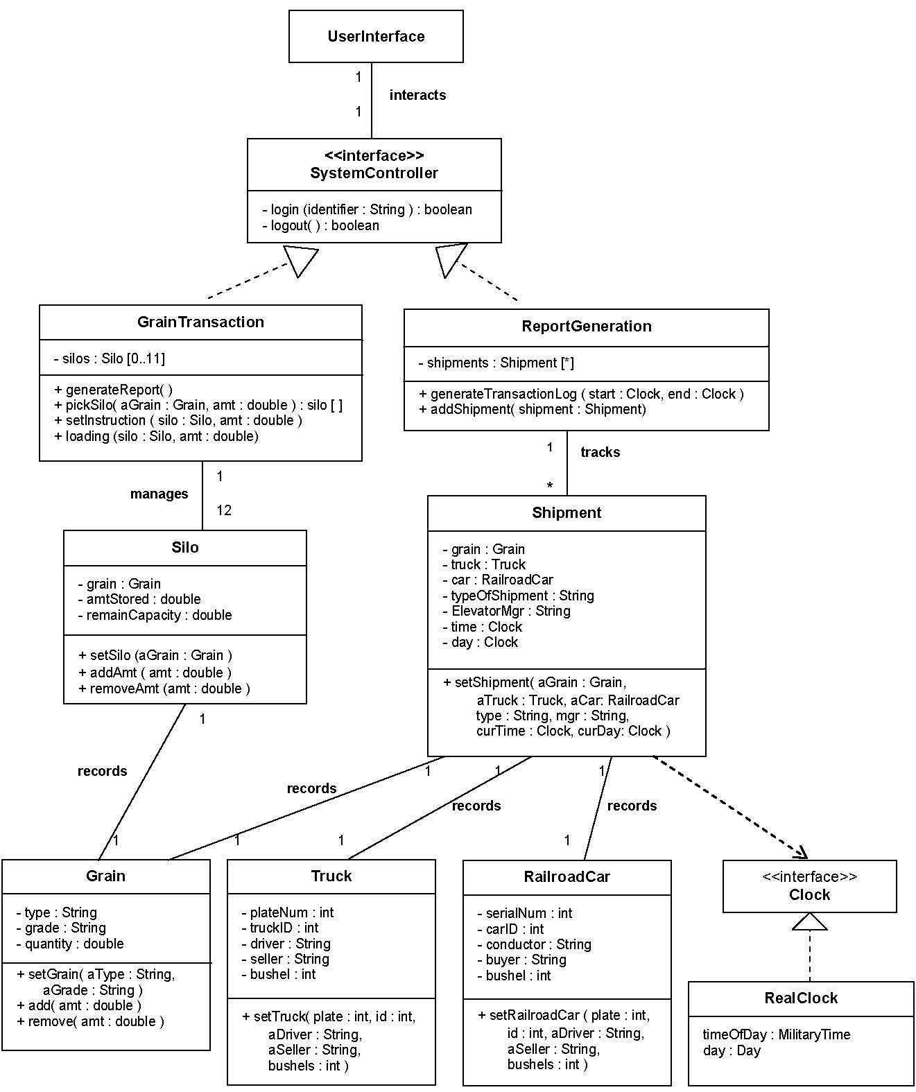

Slide 22
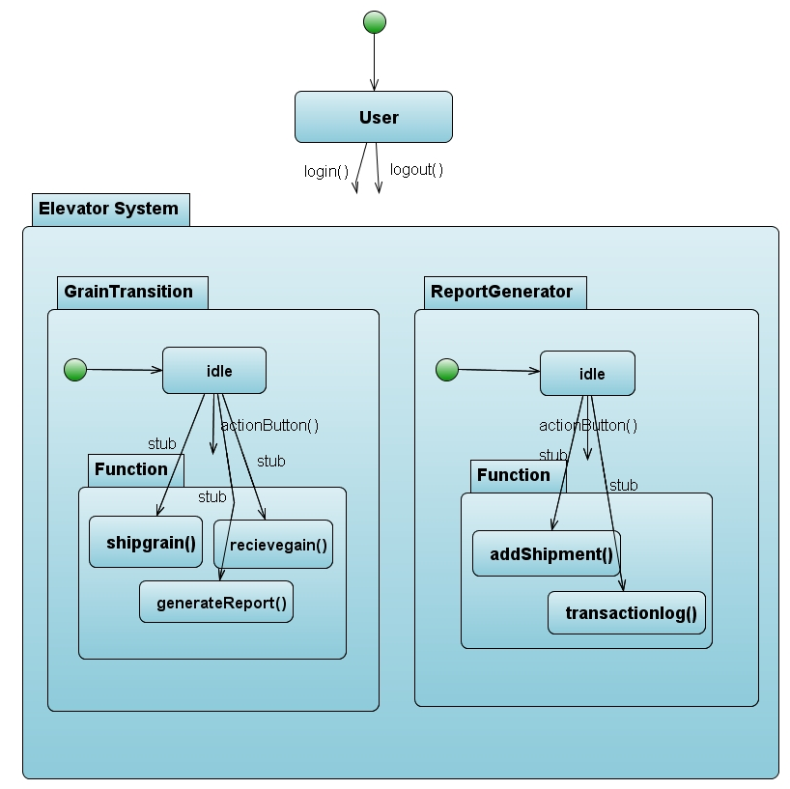
Grain Elevator System State Diagram

Slide 23
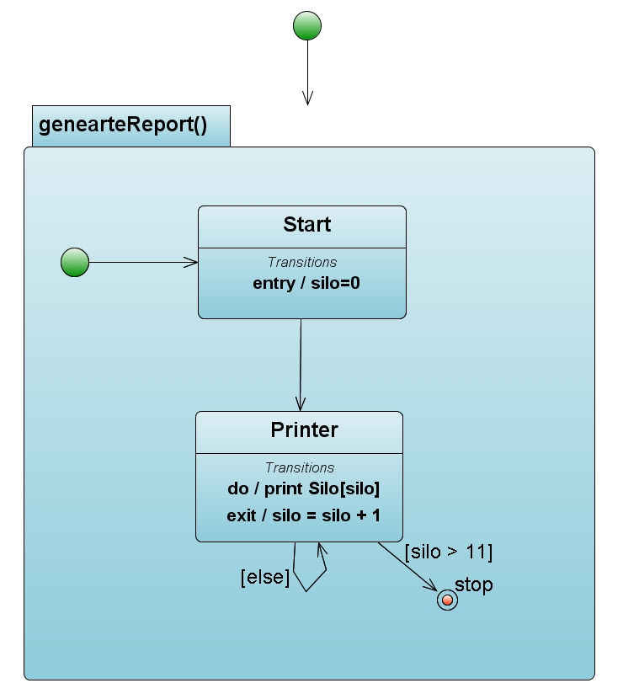
Elevator Report Generation States

Slide 24
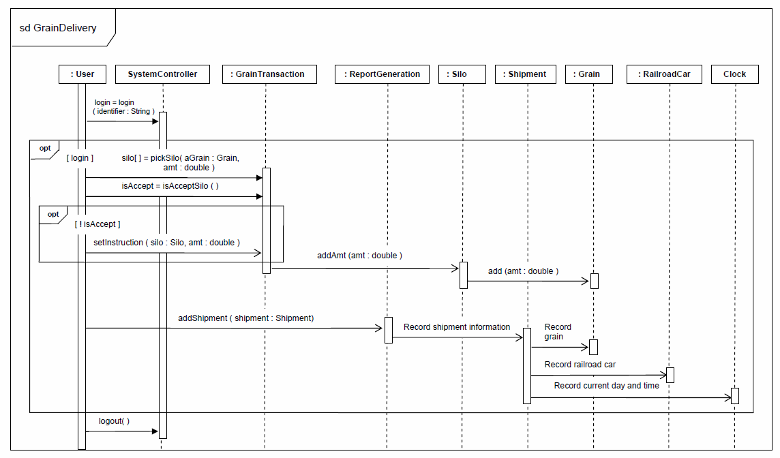

Slide 25
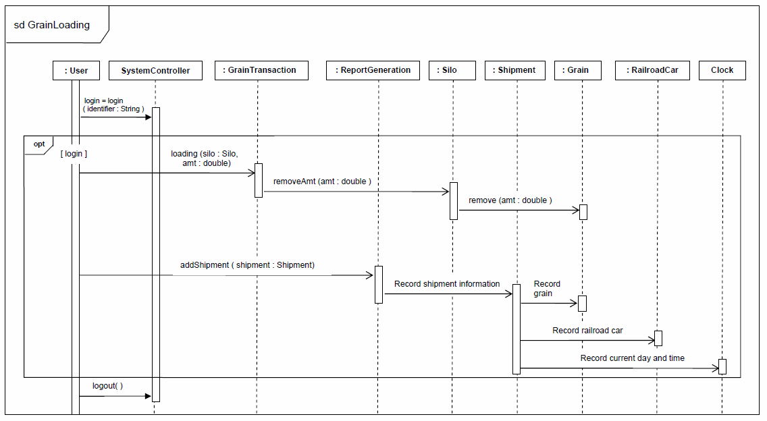

Slide 26
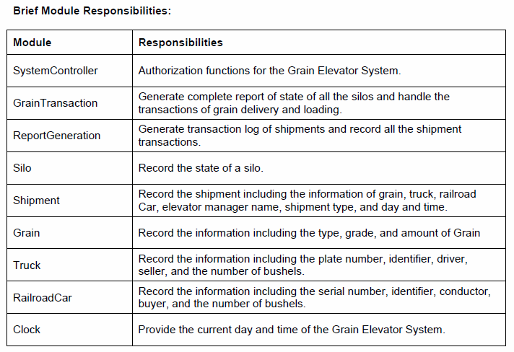

Slide 27
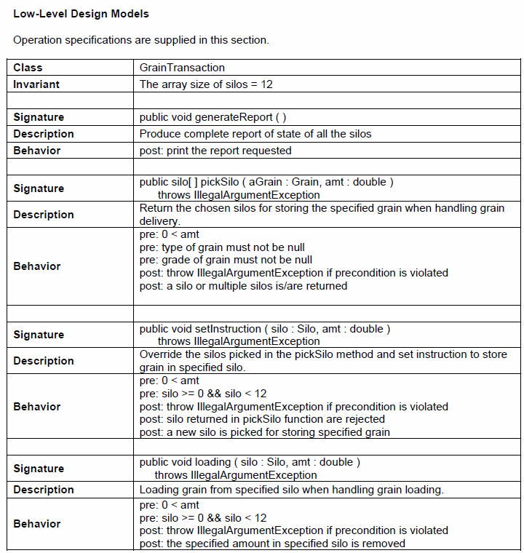

Slide 28
